Slide 1
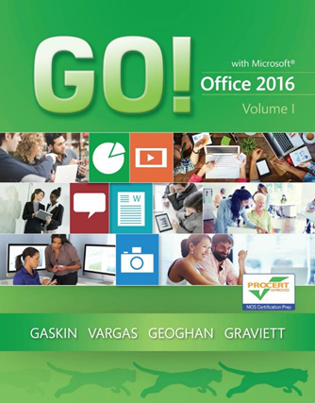
GO! with Microsoft Office 2016 Volume 1
First Edition
Windows – Chapter 1
Getting Started with Windows 10
Copyright © 2017 Pearson Education, Inc. All Rights Reserved.
Notes:
If this PowerPoint presentation contains mathematical equations, you may need to check that your computer has the following installed:
1) MathType Plugin
2) Math Player (free versions available)
3) NVDA Reader (free versions available)

Slide 2
Learning Objectives (1 of 2)
Explore the Windows 10 Environment
Use File Explorer and Desktop Apps to Create a New Folder and Save a File
Identify the Functions of the Windows 10 Operating System
Discover Windows 10 Features
Sign Out of Windows 10, Turn Off Your Computer, and Manage User Accounts

Slide 3
Learning Objectives (2 of 2)
Manage Your Windows 10 System
Download and Extract Files and Folders
Use File Explorer to Display Locations, Folders, and Files
Start Programs and Open Data Files
Create, Rename, and Copy Files and Folders
Use OneDrive as Cloud Storage

Slide 4
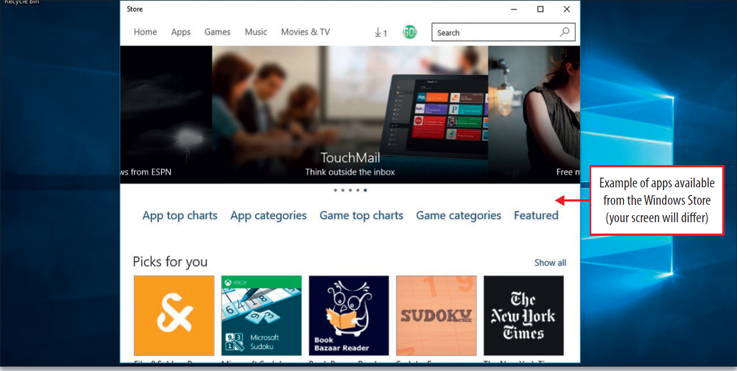
Explore the Windows 10 Environment (1 of 11)
Notes:
A program is a set of instructions that a computer uses to accomplish a task. An application is a computer program that helps you perform a task with a specific purpose. For instance, if you wanted to write a letter, you would use a word processing program such as Microsoft Word.
An operating system is a specific type of computer program that manages other programs on a computing device. Windows 10 is an operating system developed by Microsoft Corporation that works not only with computers, but also mobile computing devices.
The term desktop app (application) is commonly referred to as a computer program that is installed on the hard drive of your personal computer. Microsoft Office is an example of a full-featured program.
Windows apps are apps that run not only on a Windows phone but also on a Windows tablet and a Windows PC. Mobile apps for smart phones have their own mobile device platform. An operating system environment is referred to as a platform, which is the underlying computer system in which the application program can run.
An application developer is anyone who writes a computer application.

Slide 5
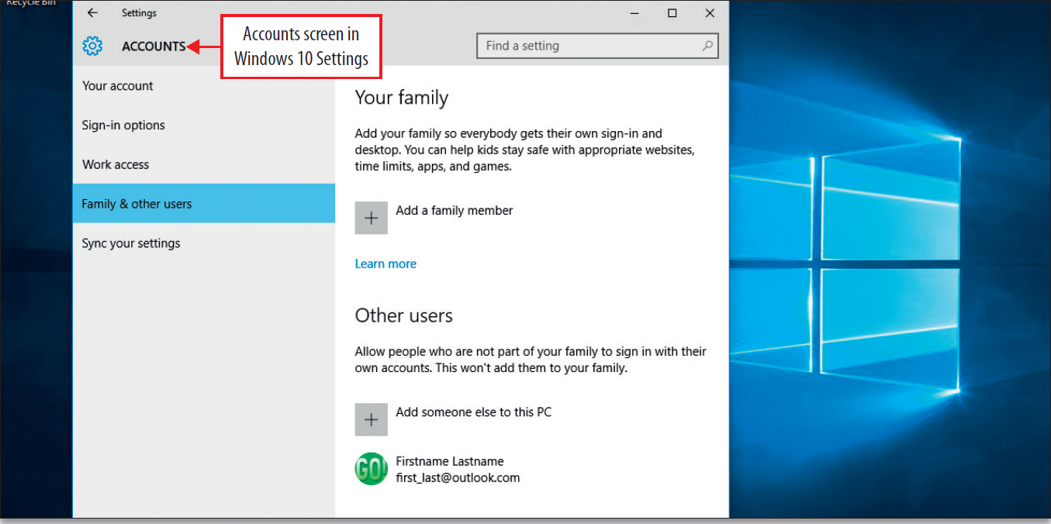
Explore the Windows 10 Environment (2 of 11)
Notes:
Windows 10 can have multiple users on the same computer. Each user has his/her own user account.
You can create a Microsoft account, and then use that account to sign in to any Windows 10 computer where you have created a user account. This allows you to:
Download apps from the Windows Store
Get your online content – email, social network updates, and updated news

Slide 6
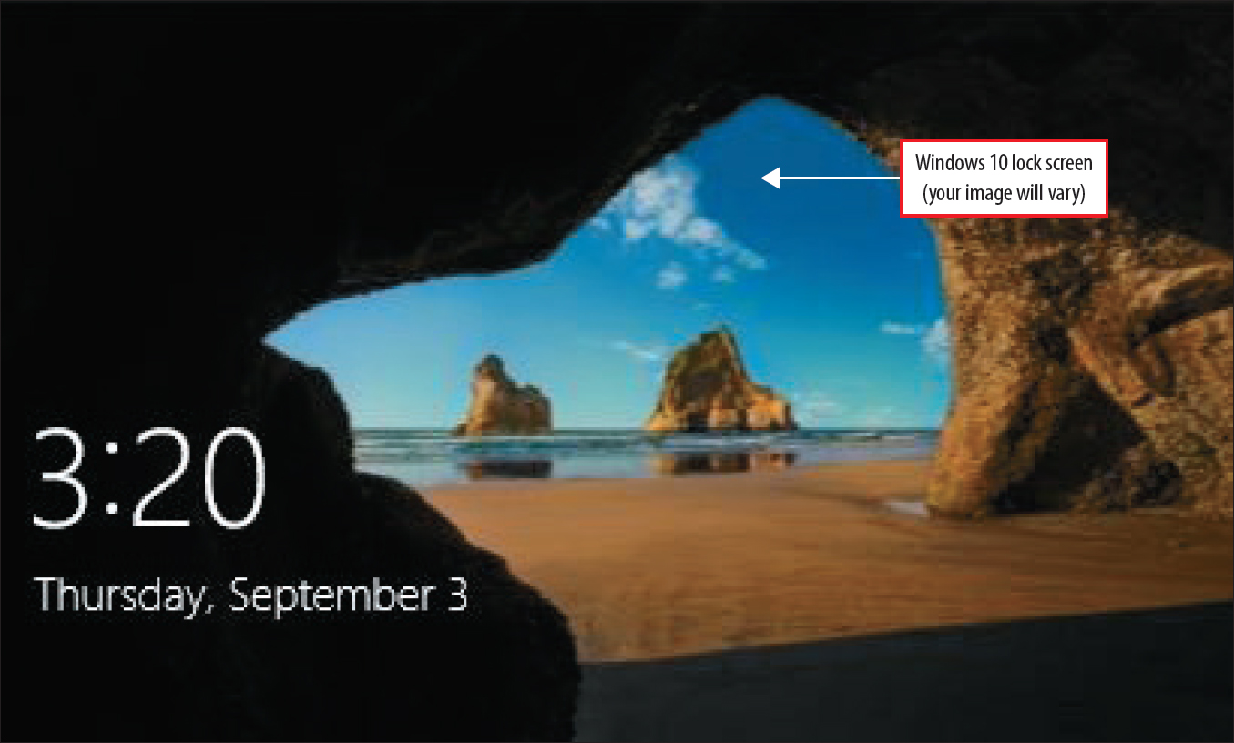
Explore the Windows 10 Environment (3 of 11)
Notes:
Before beginning any computer activity, you must turn your computer on. This is called booting the computer.
The Windows 10 displays a background that is a lock screen. The picture will vary.
You may have a standard sign-in screen with a logo or sign-in instructions, which will differ from the one shown.
Windows 10 works with both the touch screen and the mouse.
To login, press the Enter key and a sign-in screen will appear.

Slide 7
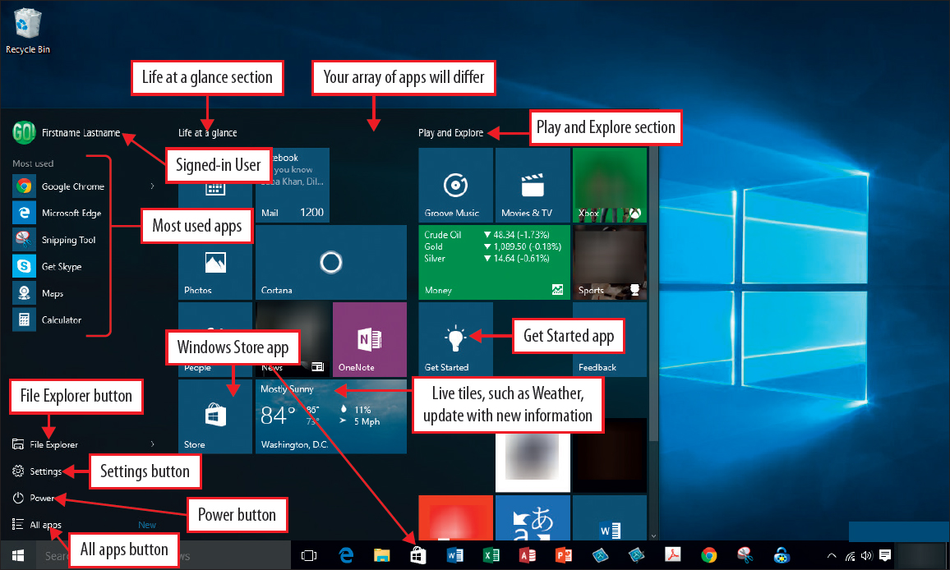
Explore the Windows 10 Environment (4 of 11)
Notes:
The Windows 10 Start menu displays a list of installed programs on the left and a customizable group of square and rectangular boxes—referred to as tiles—on the right. You can customize the arrangement of these tiles by clicking or tapping them.
The right side of the Start menu can be referred to as your connected dashboard—a one-screen view of links to information and programs that matter to you. These are programs where you connect with people, activities, places, and apps that you use. Some tiles are referred to as live tiles because they are constantly updated with fresh information relevant to you.
As you learn to work with Windows 10, you will learn to customize the Start menu and add, delete, and organize tiles into meaningful groups. You will be able to customize it to suit yourself.

Slide 8
Explore the Windows 10 Environment (5 of 11)
Parts of the Windows 10 Start Menu
All apps button | Expands the list of apps to show all installed apps in alphabetic sections.
File Explorer button | Opens the File Explorer program.
Get Started app | Displays information to help you learn about Windows 10.
Life at a glance section | Apps pinned to the Start menu that related to your own information; for example, your Mail, your Calendar; and your contacts (People); you can change this heading or delete it.
Most used apps | Displays a list of the apps that you use the most; updates as you use Windows 10.
Play and Explore section | Apps pinned to the Start menu that relate to games or news apps that you have installed; you can change this heading or delete it.
Power button | Enables you to set your computer to Sleep, Shut down, or Restart.

Slide 9
Explore the Windows 10 Environment (6 of 11)
Parts of the Windows 10 Start Menu
Settings button | Displays the Settings window to change any Windows 10 setting.
Signed-in User | Displays the name of the signed-in user.
Windows Store app | Opens the Windows Store to locate and download more apps.

Slide 10
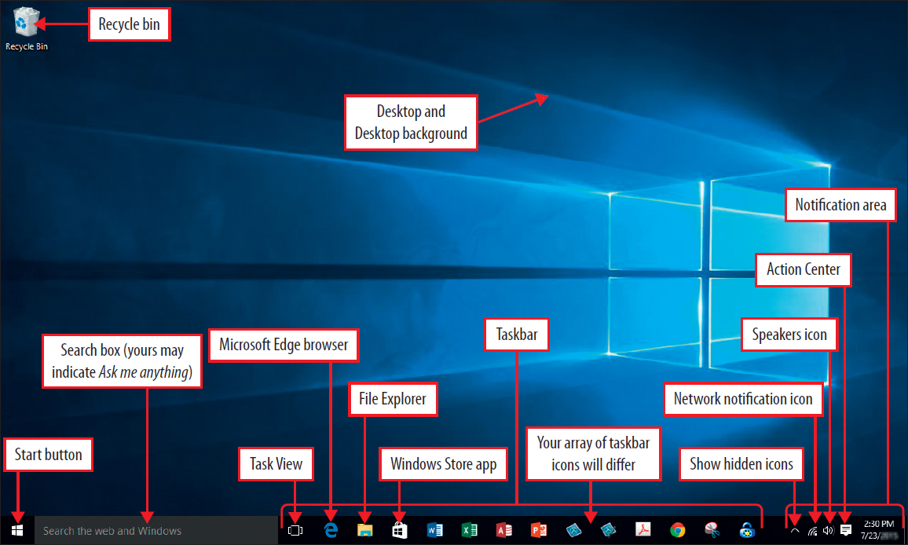
Explore the Windows 10 Environment (7 of 11)
Notes:
The Action Center is to the right of your screen where you can see app applications – such as new mail or new alerts from Microsoft or from social networks.
The Desktop serves as a surface for working, like the top of a desk. Icons, small pictures that represent a file, folder, program, or other object, are placed on the desktop for easy access.
The Desktop background displays colors and graphics of your desktop, this is referred to as wallpaper.
File Explorer displays as a file folder on the task bar. It displays contents of folders and files on your computer and on connected locations.
Microsoft Edge browser is the web browser developed by Microsoft to work with Windows 10.
Network notification icon displays the status of your network.
Notification area displays notification icons and the system clock and calendar, also referred to as the system tray.
Recycle Bin contains files and folders that you have deleted. This is a holding place for deleted items until they are permanently deleted.
Search box – this will search the web and Windows until you have set up Cortana. After Cortana is set up, this will indicate Ask me anything.

Slide 11
Explore the Windows 10 Environment (8 of 11)
Parts of the Windows 10 Desktop
Action Center | Displays the Action Center in d vertical pane on the right of your screen where you can see app notifications—such as new mail Of new alerts from Microsoft or from social networks like Facebook—at the top and access commonly used settings at the bottom.
Desktop | Serves as a surface for your work, like the top of an actual desk Here you can arrange icons—small pictures that represent a file, folder, program, or other object.
Desktop background | Displays the colors and graphics of your desktop, you can change the desktop background to look the way you want it, such as using a picture or a solid color Also referred to as wallpaper.

Slide 12
Explore the Windows 10 Environment (9 of 11)
File Explorer | Launches the File Explorer program, which displays the contents of folders and files on your computer and on connected locations, and also enables you to perform tasks related to your files and folders such as copying, moving, and renaming.
Microsoft Edge browser | Launches Microsoft Edge, the web browser program developed by Microsoft that is included with Windows 10.
Network notification icon | Displays the status of your network.
Notification area | Displays notification icons and) the system clock and calendar, sometimes referred to as the system tray.
Recycle Bin | Contains files and folders that you delete. When you delete a file or folder from a location on your hard disk drive, it is not actually deleted; it stays in the Recycle Bin if you want it back, until you take an action to empty the Recycle Bin.

Slide 13
Explore the Windows 10 Environment (10 of 11)
Search box | Before Cortana—Microsoft's intelligent personal assistant—is set up, this will indicate Search the web and Windows. After Cortana is set up, this will indicate Ask me anything. Regardless, you can type in the box to begin a search of your computer and the web.
Show hidden icons | Displays additional icons related to your notifications.
Speakers icon | Displays the status of your computers speakers (if any)
Stat button | Displays the Start menu
Task View | Displays your desktop background with a small image of all open programs and apps. Click once to open, click again to dose.

Slide 14
Explore the Windows 10 Environment (11 of 11)
Taskbar | Contains buttons to launch programs and buttons for all open programs, by default, it is located at the bottom of the desktop, but you can move it You can customize the number and arrangement of buttons.
Windows Store | Opens the Windows Store where you can select and download Windows apps

Slide 15
Use File Explorer and Desktop Apps to Create a New Folder and Save a File (1 of 7)
Parts of the File Explorer Window
Address bar | Displays your current location in the folder structure as a series of links separated by arrows.
Back and Forward buttons | Provides the ability to navigate to other folders you have already opened without closing the current folder window. These buttons work with the address bar; that is, after you use the address bar to change folders, you can use the Back button to return to the previous folder.
Close button | Closes the window.
File list | Displays the contents of the current folder or location; if you type text into the Search box, only the folders and files that match your search will display here—including files in subfolders.

Slide 16
Use File Explorer and Desktop Apps to Create a New Folder and Save a File (2 of 7)
Frequent folders area | When Quick access is selected in the navigation pane, displays the folders you use frequently.
Help button | Opens a Ring search for Windows 10 help.
Maximize button | Increases the size of a window to fill the entire screen.
Minimize button | Removes the window from the screen without closing it; minimized windows can be reopened by clicking the associated button in the taskbar.
Minimize the Ribbon button | Collapses the ribbon so that only the tab names display.
Navigation pane | Displays—for the purpose of navigating to locations—the Quick access area, your OneDrive if you have one and are signed in, locations on the PC at which you are working, any connected storage devices, and network locations to which you might be connected.

Slide 17
Use File Explorer and Desktop Apps to Create a New Folder and Save a File (3 of 7)
OneDrive | Provides navigation to your free file storage and file sharing service provided by Microsoft that you get when you sign up for a Microsoft account; this is your personal cloud storage for files.
Previous Locations button | Displays the path to locations you have visited recently so that you can go back to a previously working directory quickly.
Quick access area | Displays commonly accessed locations—such as Documents and Desktop—that you want to access quickly.
Quick Access Toolbar | Displays commonly used commands; you can customize this toolbar by adding and deleting commands and by showing the toolbar below the ribbon instead of above the ribbon.

Slide 18
Use File Explorer and Desktop Apps to Create a New Folder and Save a File (4 of 7)
Refresh button | Refreshes the current path.
Ribbon | Groups common tasks on related tabs at the top of the window; for example, copying and moving, creating new folders, emailing and zipping items, and changing views.
Search box | Locates files stored within the current folder when you type a search term.
This PC | Provides navigation to your internal storage and attached storage devices including optical media such as a DVD drive.
Up button | Opens the location where the folder you are viewing is saved—also referred to as the parent folder.

Slide 19
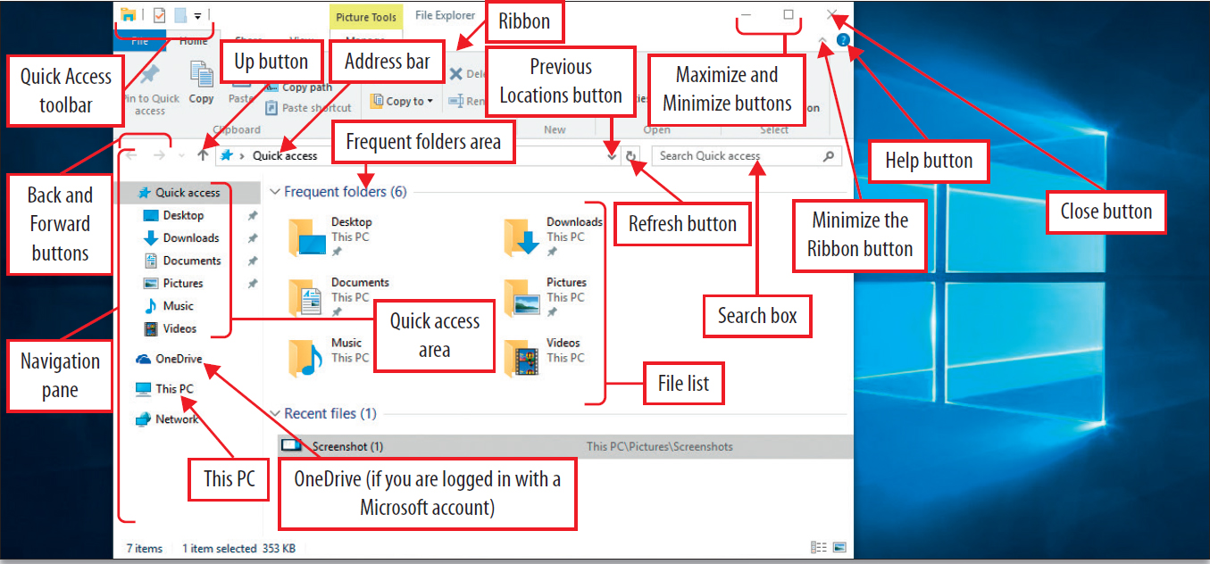
Use File Explorer and Desktop Apps to Create a New Folder and Save a File (5 of 7)
Notes:
A file is a collection of information stored on a computer under a single name. A folder is a container for stored files. Windows 10 organizes and keeps track of electronic files by letting you create and label folders in which you place your files.
A removable storage device is a device like a USB flash drive, that can be used to store or transfer files and folders from one place to another.
A drive is an area of storage formatted with a file system compatible with our operating system and identified by drive letter. Your computer’s hard disk drive is usually the primary storage area of files and folders. It is usually designated as Drive C. The letter designation of removable storage devices will vary between computer to computer.
With Windows 10, you will learn about cloud storage, which is storage space on an Internet site that can also display as a drive on your computer. When you create a Microsoft account, you will receive free cloud storage called OneDrive. OneDrive can be accessed from File Explorer.
The File Explorer window displays with the Quick access area selected by default. File Explorer displays the contents of the current location, and contains helpful parts so you can navigate to the location of your files or folders.

Slide 20
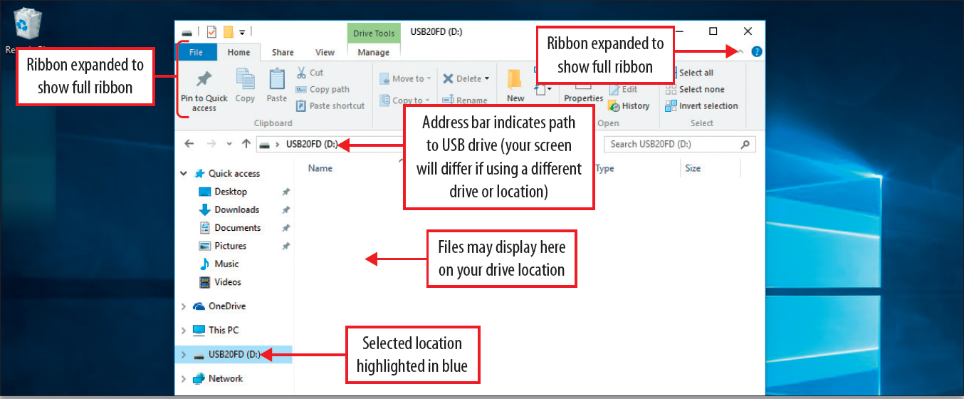
Use File Explorer and Desktop Apps to Create a New Folder and Save a File (6 of 7)
Notes:
The ribbon is a user interface in Windows 10 that groups commands for performing related tasks on tabs across the upper portion of a window.
The navigation pane is the area on the left side of the File Explorer window that gives the location of folders on your PC, and devices and drives connected to your PC.
A shortcut menu is a content-sensitive menu that displays commands and options relevant to the active object.
A contextual tab is a tab that is added to the ribbon automatically when a specific object is selected and contains commands relevant to the selected object.
The address bar displays the current location in the folder structure as a series of links separated by arrows.

Slide 21
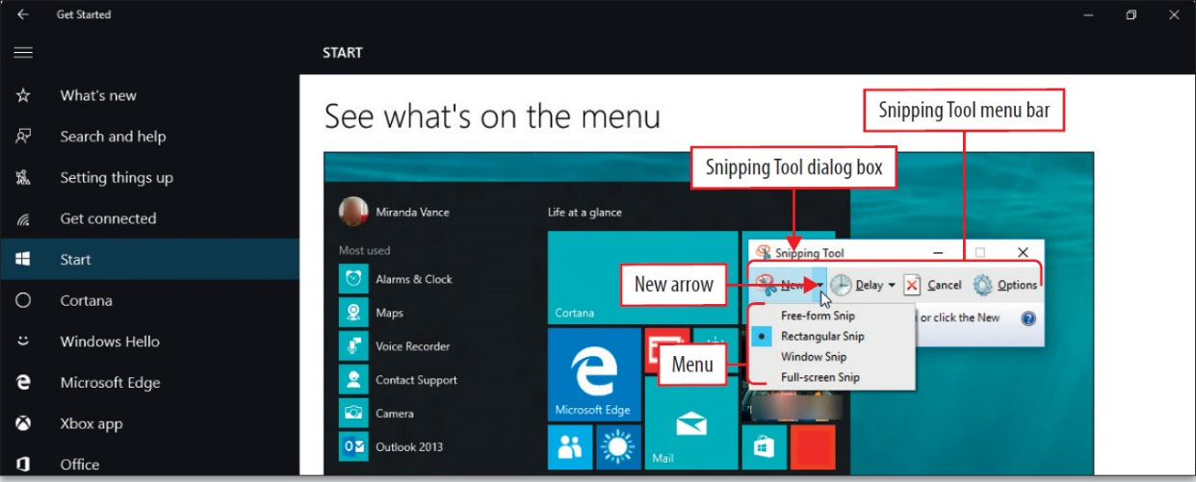
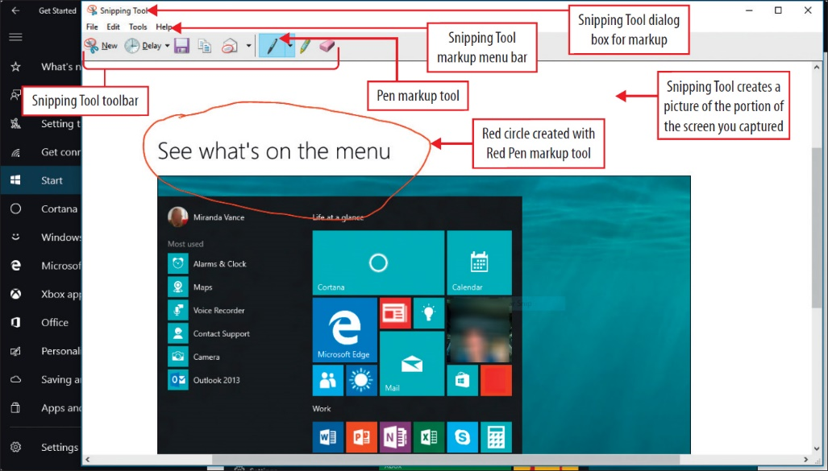
Use File Explorer and Desktop Apps to Create a New Folder and Save a File (7 of 7)
Notes:
Snipping Tool is a program in Windows 10 that captures an image, or all or part of your computer screen. A snip is the captured image.
A free-form snip enables you to draw an irregular line such as a circle around an area on the screen.
A rectangular snip enables you to draw a precise box by dragging the mouse pointer around an area to form a rectangle.
A window snip captures the entire displayed window.
A full-screen snip captures the entire screen.

Slide 22
Identify the Functions of the Windows 10 Operating System
Notes:
The three major tasks of an operating system are:
Manage the computer’s hardware
Manage the application software installed on the computer
Manage the data generated and stored on your computer
Windows 10 is similar to earlier versions of Windows in that it has a desktop that uses a graphical user interface (GUI) which uses graphics as an image of file folders or wastebasket. A GUI commonly includes the following:
Pointer which is a symbol that displays on the screen in response to moving the mouse
Pointing device which is a mouse or touchpad which controls the pointer
Icons which are small images that represent commands, files, applications, and other windows.
A desktop which is a simulated desk top or your work space. Icons for programs, files, folders, and various types of documents can be arranged on your desktop.

Slide 23
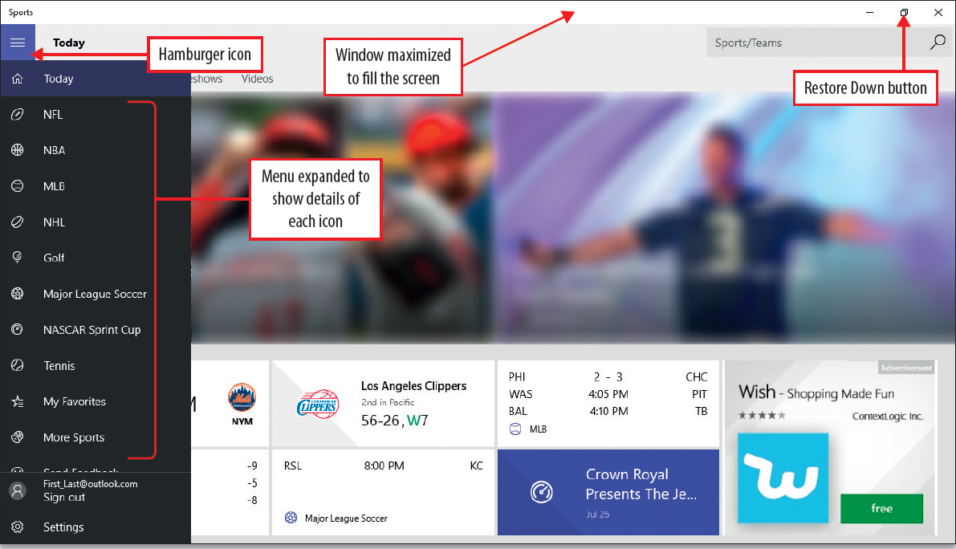
Discover Windows 10 Features (1 of 5)
Notes:
Some of the built-in apps that come with a new installation of Windows 10 are:
Mail
Weather
Sound Recorder
Sports
News
You can add apps to your Start menu by pinning them to Start.

Slide 24
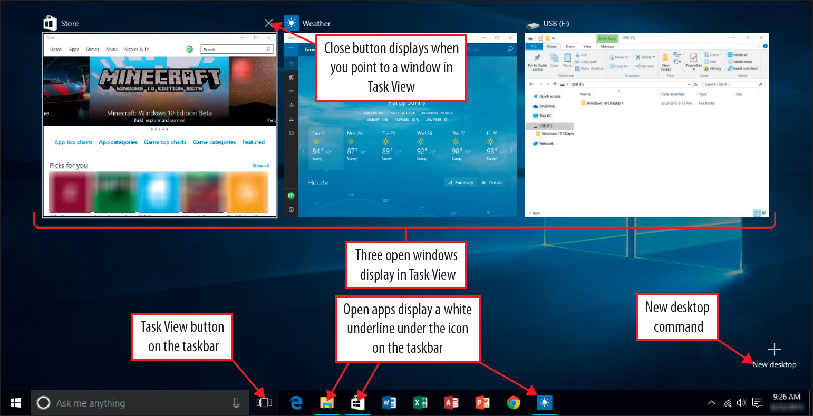
Discover Windows 10 Features (2 of 5)
Notes:
Use the Task View button on the taskbar to see and switch between open apps. Use Snap Assist to display a 50/50 split screen view of two apps. Drag the title bar (the bar at the top of the window) to the right or left until it snaps into place. You can snap up to four apps by dragging their title bars into the corners of your screen. Task view displays a thumbnail—reduced image of a graphic—of each open window.

Slide 25
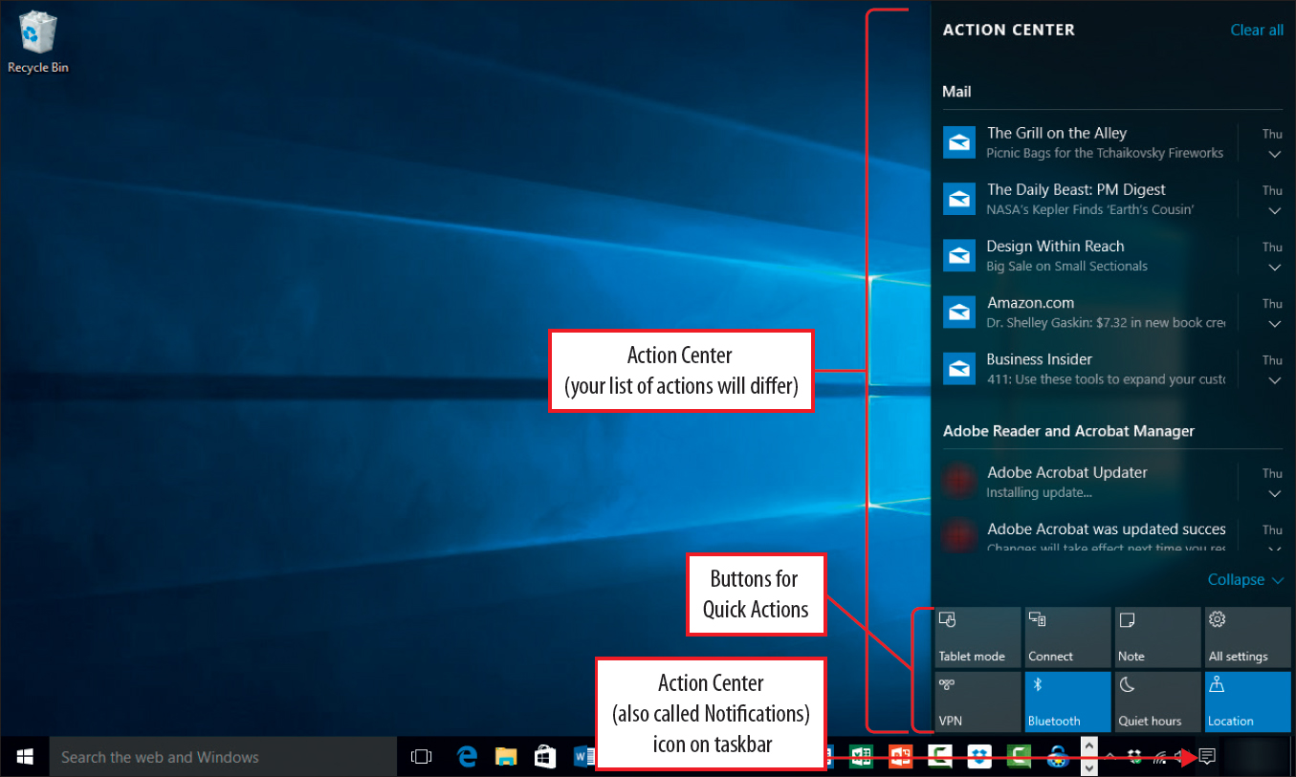
Discover Windows 10 Features (3 of 5)
Notes:
The Action Center is a vertical panel that displays on the right side of your screen when you click the icon in the notification area of the taskbar. The top portion displays notifications from apps you have installed and those you have elected to receive notifications from. The bottom portion displays Quick Actions, which are buttons that take you to frequently used system commands.

Slide 26
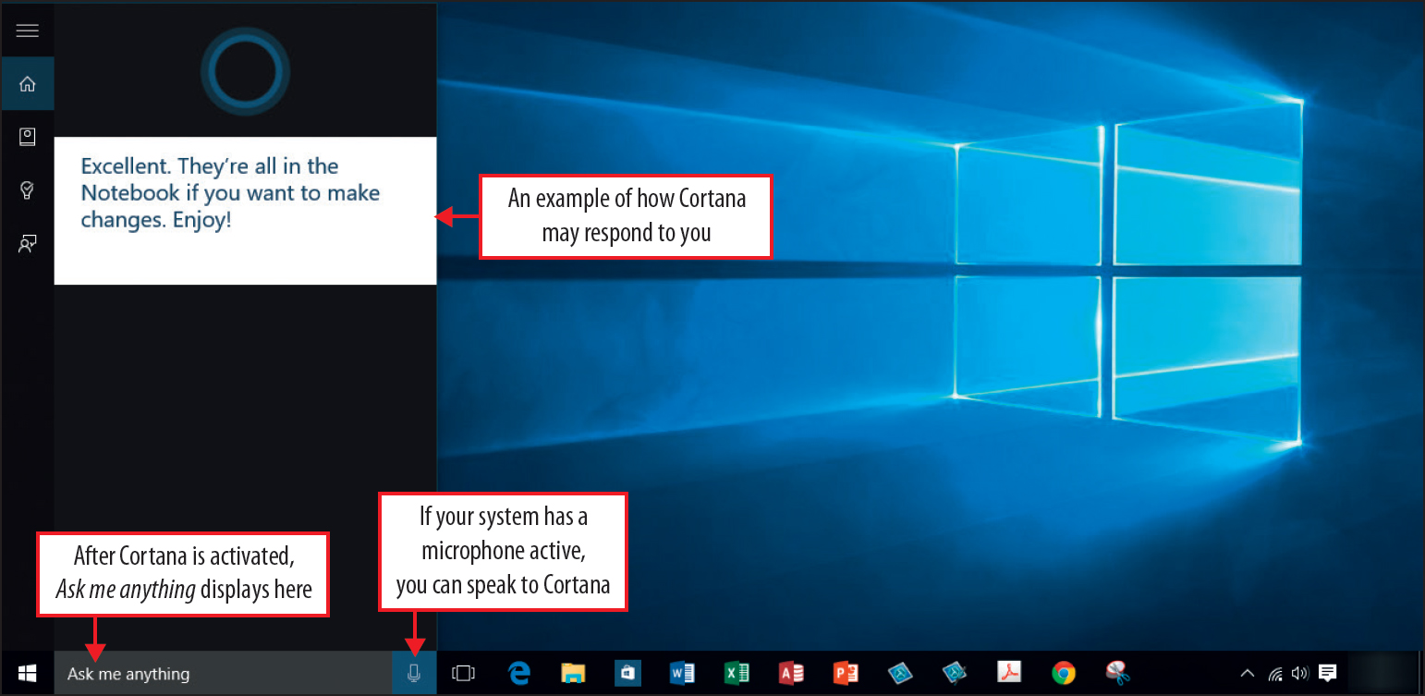
Discover Windows 10 Features (4 of 5)
Notes:
Cortana is the name for the intelligent female character in the Halo video game series. She is also the name for the personal digital assistant in Windows 10. Once installed, you can speak your requests to Cortana instead of typing them.

Slide 27
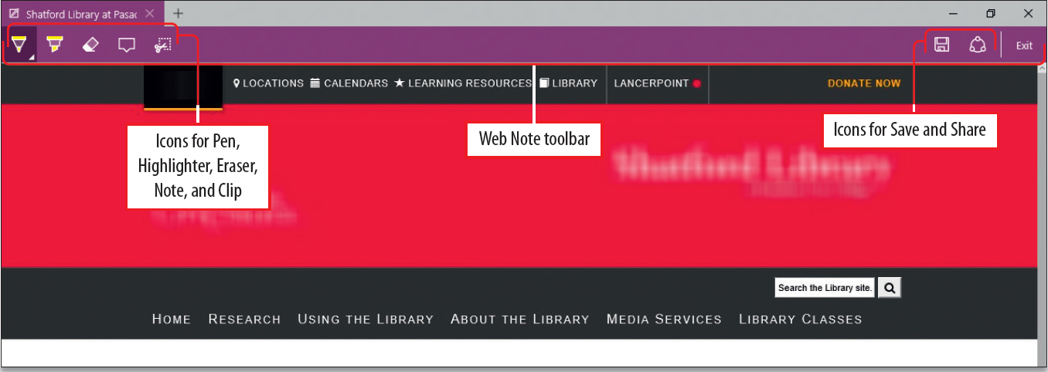
Discover Windows 10 Features (5 of 5)
Notes:
Microsoft Edge is the web browser program that comes with Windows 10. It gives you the ability to:
Enter a search directly into the address bar
Save sites and favorites and reading lists in the Hub feature
Take notes and highlight directly on a webpage and then share that page with someone
Pin a website to your Start menu

Slide 28
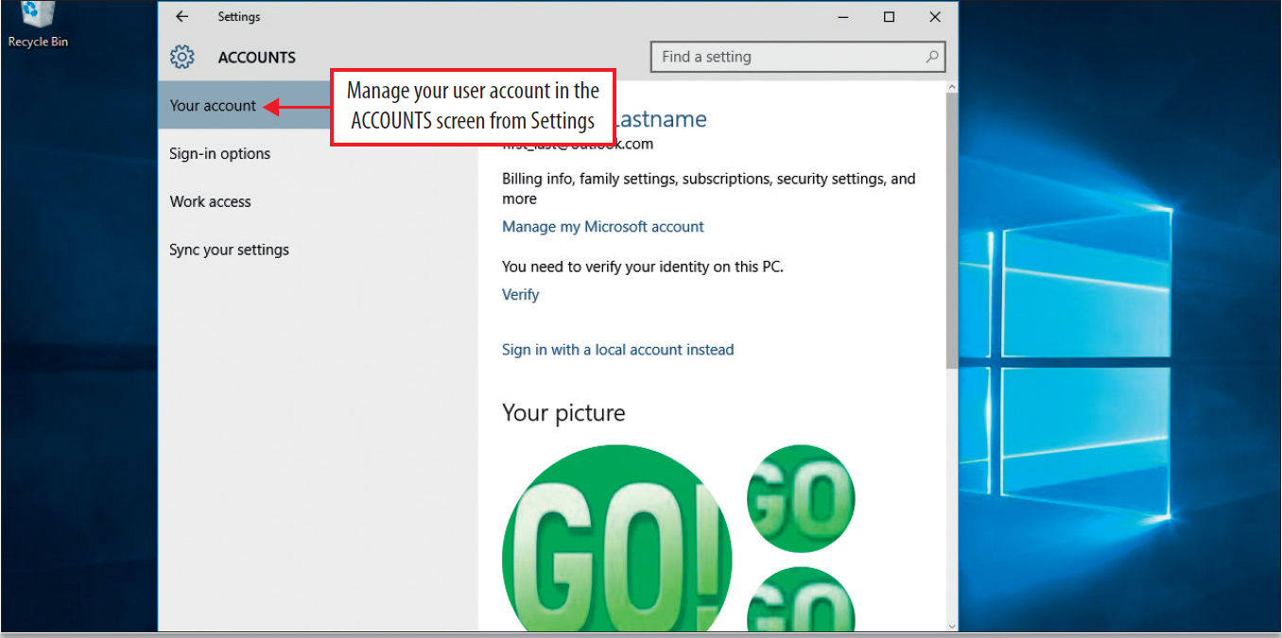
Sign Out of Windows 10, Turn Off Your Computer, and Manager User Accounts
Notes:
When you turn off your computer by using the Sleep command, Windows 10 automatically saves your work, the screen goes dark, the computer’s fan stops, and your computer goes to sleep.
When you shut down your computer, all open programs and files close, network connections close, and the hard disk stops. The power is off.
Windows 10 supports multiple local account users on a single computer, at least one user is the administrator. The administrator restricts access on your computer so only those who are authorized to use your computer can do so. The screen is managed through user accounts, which is a collection of information that tells Windows 10 what files and folders the account holder can access.
An administrator account allows complete access to the computer. Administrators can make changes that affect other users, change security settings, install software and hardware, access all files, and make changes to other user accounts.

Slide 29
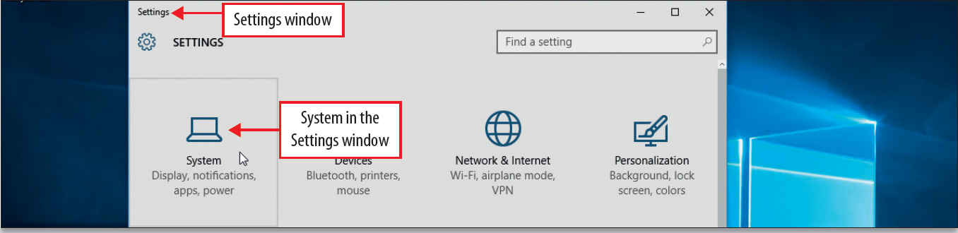
Managing Your Windows 10 System
Notes:
Because Windows 10 is a modern operating system, it will receive updates on a regular basis.
The backup and recovery tools available in Windows 10 include:
File History which can automatically back up your most important files to a separate location
PC Reset which lets you return your PC to the condition it was in the day you bought it
System image backup which creates a full system image backup from which you can restore your PC
Windows Defender is a protection built into Windows 10 that helps prevent viruses, spyware, and malicious or unwanted software from being installed on your PC without your knowledge.
Windows Firewall is protection that can prevent hackers or malicious software from gaining access to your computer through a network or the Internet.
The Control Panel is an area where you can manipulate some of the Windows 10 basic system settings.

Slide 30
Download and Extract Files and Folders
Download – transferring or copying a file from one location to another
Compressed files – files reduced in size to take up less space
Extract – means to decompress compressed files
Zip and unzip – the process of compressing and extracting
Compressed Folder Tools – on the ribbon to help in extracting compressed files

Slide 31
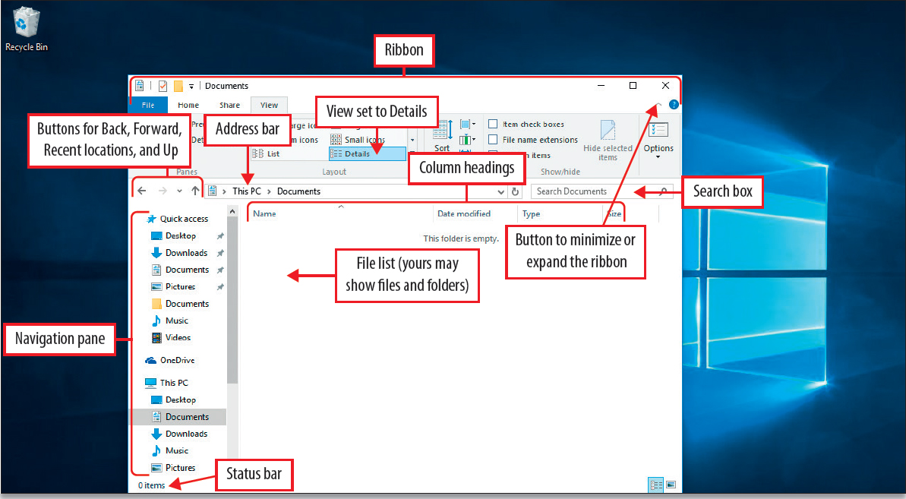
Use File Explorer to Display Locations, Folders, and Files
Notes:
A file is the fundamental unit of storage on the computer. A folder is the basic organizing tool for files. A folder can be created inside a folder, this is referred to as a subfolder.
Windows 10 arranges folders in a hierarchy – an arrangement where items are ranked. The hierarchy of folders is referred to as folder structure. A sequence of folders in a folder is referred to as a path.
File Explorer is the program that displays the contents of locations, folders, and files on your computer and also in your OneDrive or other cloud storage.
A file list displays the contents of a folder or location. The details pane displays the most common file properties associated with a selected file. File properties refer to information about a file, such as author, date of the last change, and any descriptive tags that have been added to the properties.

Slide 32
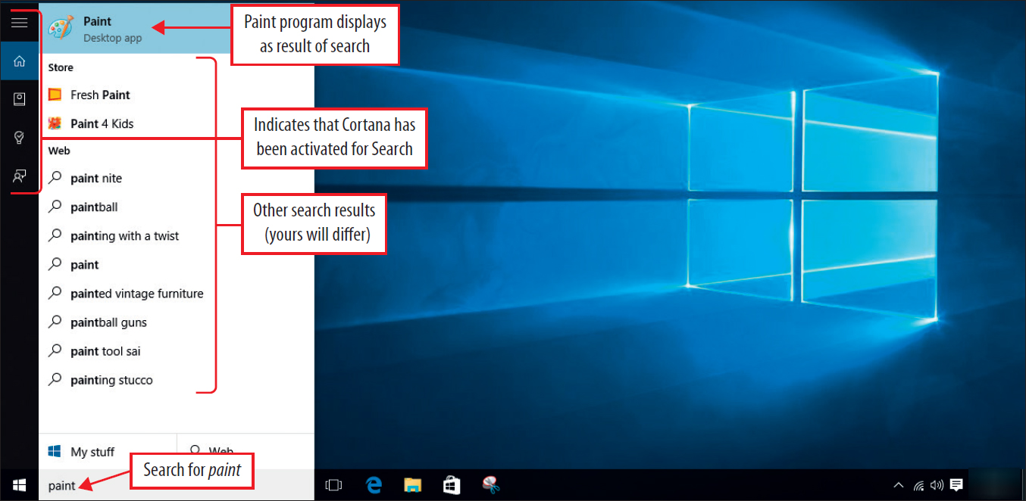
Start Programs and Open Data Files (1 of 5)
Notes:
You can start programs from the Start menu or from the taskbar by pinning a program to the taskbar. You can open your data files from within the program or from File Explorer.

Slide 33
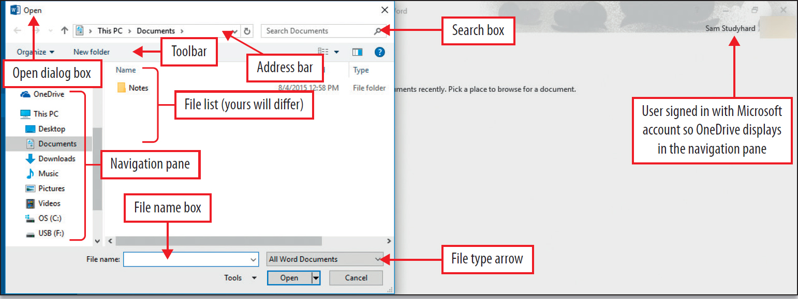
Start Programs and Open Data Files (2 of 5)
Notes:
There are a list of places from which you can open a document. A dialog box is a window containing options for completing a task. It is similar to the File Explorer window. When you are working in a desktop application, use the Open dialog box to locate and open existing files.
The Address bar displays the path in the folder structure.
The file list is a list of the files and folders in the specific folder you have specified.
File name box enables you to type the name of a specific file if you know it.
The File type arrow enables you to restrict the type of files displayed in the file list.
The Navigation pane helps you navigate to files and folders.
The Search bar searches for files in the current folder.
Toolbar displays relevant tasks like creating a new folder.

Slide 34
Start Programs and Open Data Files (3 of 5)
Dialog Box Element | Function
Address bar | Displays The path in the folder structure.
File list | Displays the list of files and folders that are available in the folder indicated in the address bar.
File name box | Enables you to type the name of a specific file to locate it—if you know it.
File type arrow | Enables you to restrict the type of files displayed in the file list; for example, the default All Word Documents restricts (filters) the type of files displayed to only Word documents. You can click the arrow and adjust the restrictions (filters) to a narrower or wider group of files.

Slide 35
Start Programs and Open Data Files (4 of 5)
Dialog Box Element | Function
Navigation pane | Navigate to files and folders and get access to Quick access, OneDrive, and This PC.
Search box | Search for files in the current folder. Filters the file list based on text that you type; the search is based on text in the file name (and for files on the hard drive or OneDrive, in the file itself), and on other properties that you can specify. The search takes place in the current folder, as displayed in the address bar, and in any subfolders within that folder.
Toolbar | Displays relevant tasks; for example, creating a new folder.

Slide 36
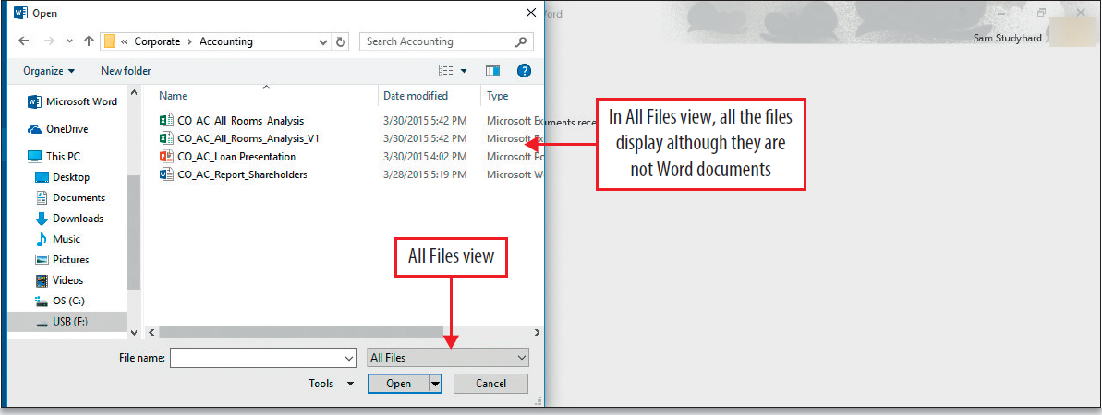
Start Programs and Open Data Files (5 of 5)
Notes:
File name extensions are a set of characters at the end of a file name that helps Windows understand what kind of information is in the file and what program should open it. A .txt file is a simple file consisting of lines of text with no formatting that almost any computer can open and display.
In the file list, you can filter the list by clicking on the Type column heading. It will filter according to what type of tile it is.

Slide 37
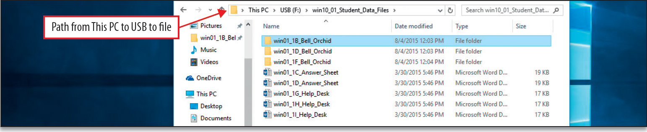
Create, Rename, and Copy Files and Folders (1 of 2)
Notes:
File management includes organizing, copying, naming, renaming, moving, and deleting files and folders that you have stored in various locations.
The copy command places a copy of your selected file or folder on the Clipboard where it will be stored until you use the Paste command to insert the copy somewhere else. The Clipboard is temporary storage; when the computer is powered down, the Clipboard is emptied.
When you Paste from the clipboard, you replace what was there before. In Windows 10, you cannot put multiple items in the clipboard like you can in Microsoft Word.
A progress bar displays a dialog box, and also displays on the File Explorer taskbar button with green shading. A progress bar indicates visually the progress of the copy process, a download, or a file transfer.

Slide 38
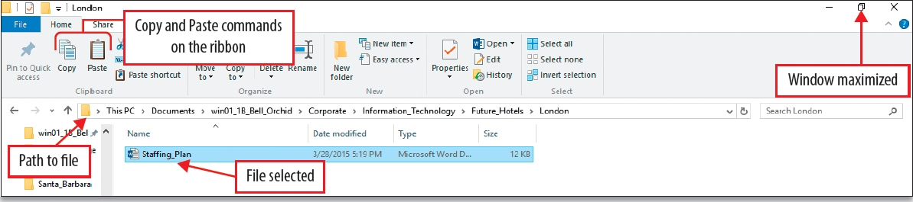
Create, Rename, and Copy Files and Folders (2 of 2)
Notes:
Copying, moving, renaming, and deleting files and folders comprise the most heavily used features in File Explorer. When you copy a file or folder, you make a duplicate of the original item and store it in another location.
You can also use the CTRL key with the mouse to engage the copy command and place a copy in the location you want it to go.
Moving a file or folder removes it from its original location and stores it in a new location.
It’s a good practice to delete files and folders that you no longer need from your hard disk drive and removable storage device. Deleting from your computer places the files and folders in the recycle bin until the recycle bin is emptied. As long as the recycle bin has not been emptied, you can restore files and folders to their original location. Deleting files and folders from removable storage devices is permanent.

Slide 39
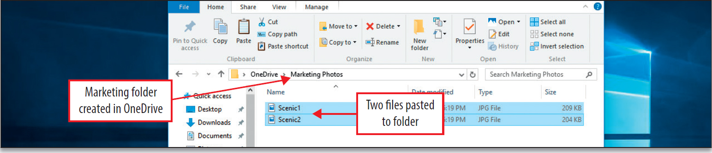
Use OneDrive as Cloud Storage
Notes:
OneDrive is Microsoft’s cloud storage. Cloud storage means that your data is stored on a remote server that is maintained by a company so you have easy access to your files.
OneDrive is integrated into Windows 10 operating system. OneDrive is similar to Google’s Google Drive that is integrated into Chrome, and Apple’s iCloud which is integrated into both Max and iOS operating systems.

Slide 40
Summary
Windows 10 is optimized for touchscreens and with the mouse and keyboard
The Windows 10 Start menu is your one-screen view of information called your dashboard
Windows Store apps used from the Start menu display in separate windows
File Explorer is used to navigate your Windows 10 structure
Notes:
Windows 10 is optimized to touchscreens and with the mouse and keyboard.
The Windows 10 Start menu is your one-screen view of information called your dashboard.
Windows Store apps used from the Start menu display in separate windows.
File Explorer is used to navigate your Windows 10 structure.

Slide 41

Questions

Slide 42

Copyright

